Slide 1

HTTP Protocol​
Handling Requests, ​ Constructing Responses, HTTP/2 & HTTP/3
SoftUni Team
Technical Trainers
Software University
https://softuni.bg

Slide 2
Table of Content
HTTP Basics
URL
HTTP Request
HTTP Response
MIME and Media types
Routing in Web
HTTP Dev Tools
Web Server
HTML Forms
HTTP/2
HTTP/3

Slide 3
Questions?
sli.do
#csharp-web

Slide 4

HTTP Basics​
Basic Concepts

Slide 5
What is a Protocol?
A communication protocol is a set of rules, which define how two or more parties are talking to each other.
It is like a common language used for communication between machines.

Slide 6


Hyper Text Transfer Protocol
Request
Response
HTTP
HTTP
TCP
TCP
IP
IP
Media (wires / air / fiber)
Ethernet
Ethernet
Notes:
HTTP == Hyper Text Transfer Protocol
Client-server protocol for transferring Web resources (HTML files, images, styles, scripts, data, etc.)
The widespread protocol for Internet communication today
Request-response model (client requests, server answers)
Text-based format (human readable)
Relies on unique resource URLs
Provides resource metadata (e.g. encoding)
Stateless (cookies and Web storages can overcome this)

Slide 7
HTTP Protocol (1)
HyperText Transfer Protocol
Standard protocol used to transmit data across the web
General-purpose client-server protocol for the Internet
For transferring Web resources
HTML files
Images
Documents
Audio
And more

Slide 8
HTTP Protocol (2)
Text-based client-server protocol
Uses the request-response model
The client sends a request for a given data
The server returns a response with the requested data
Relies on URLs
Stateless
Each HTTP request is independent from the others
Cookies and Web storages can overcome this

Slide 9
HTTP Request Methods
HTTP defines methods to indicate the desired action to be performed on the identified resource
Method | Description
GET | Retrieve / load a resource
POST | Create / store a resource
PUT | Update a resource
DELETE | Remove a resource

Slide 10
HTTP Conversation: Example
GET /courses/javascript HTTP/1.1
Host: www.softuni.bg
User-Agent: Mozilla/5.0
<CRLF>
HTTP request:
HTTP response:
The empty line denotes the end of the request header
HTTP/1.1 200 OK
Date: Mon, 5 Jul 2020 13:09:03 GMT
Server: Microsoft-HTTPAPI/2.0
Last-Modified: Mon, 12 Jul 2014 15:33:23 GMT
Content-Length: 54
<CRLF>
<html><title>Hello</title>
Welcome to our site</html>
The empty line denotes the end of the response header

Slide 11

URL
Uniform Resource Locator

Slide 12
Uniform Resource Locator (URL)
http://localhost:8080/demo/index.html?id=27&lang=en#lecture
Protocol
Host
Port
Path
Query String
Fragment
URL is a formatted string, consisting of:
Protocol for communicating (http, ftp, https...) – HTTP in most cases
Host or IP address (www.softuni.bg, gmail.com, 127.0.0.1, web)
Port (the default port is 80) – a number in range [0…65535]
Path (/forum, /path/index.html)
Query string (?id=27&lang=en)
Fragment (#lectures) – used on the client to navigate to some section

Slide 13
URL Encoding
URLs are encoded according RFC 1738:
Safe URL characters: [0-9a-zA-Z], $, -, _, . , +, *, ', (, ), ,, !
All other characters are escaped by:
Space is encoded as "+" or "%20"
URL-encoded string:
Char | URL Encoding
space | %20
щ | %D1%89
" | %22
# | %23
$ | %24
% | %25
& | %26
%[character hex code]
Наков-爱-SoftUni
%D0%9D%D0%B0%D0%BA%D0%BE%D0%B2-%E7%88%B1-SoftUni

Slide 14
Valid and Invalid URLs – Examples
Some valid URLs:
Some invalid URLs:
http://www.google.bg/search?sourceid=navclient&ie=UTF-8&rlz=1T4GGLL_enBG369BG369&q=http+get+vs+post
http://bg.wikipedia.org/wiki/%D0%A1%D0%BE%D1%84%D1%82%D1%83%D0%B5%D1%80%D0%BD%D0%B0_%D0%B0%D0%BA%D0%B0%D0%B4%D0%B5%D0%BC%D0%B8%D1%8F
Should be: ?q=C%23+.NET+6.0
http://www.google.bg/search?&q=C# .NET 6.0
Should be: ?q=%D0%B1 %D0%B8%D1%80%D0%B0
http://www.google.bg/search?&q=бира

Slide 15

HTTP Request​
What is a HTTP Request?

Slide 16
HTTP Request Message
Request message sent by a client consists of:
HTTP request line
Request method (GET / POST / PUT / DELETE / …)
Resource URI (URL)
Protocol version
HTTP request headers
Additional parameters
HTTP request body – optional data, e.g. posted form fields
<method> <resource> HTTP/<version>
<headers>
(empty line)
<body>

Slide 17
HTTP GET Request
GET is used to request data from a specified resource
Example of HTTP GET request:
GET /index.html HTTP/1.1
Host: localhost
<CRLF>
HTTP request line
HTTP request headers
HTTP request body is empty

Slide 18
HTTP POST Request
The POST method transfers data in the HTTP body
Example of HTTP POST request:
HTTP request headers
POST /login.html HTTP/1.1
Host: localhost
Content-Length: 59
Content-Type: application/x-www-form-urlencoded
<CRLF>
username=testUser&password=topSecret
<CRLF>
HTTP request line
HTTP request body holds the submitted form data

Slide 19

HTTP Response​
What is a HTTP Response?

Slide 20
HTTP Response Message
The response message sent by the HTTP server consists of:
HTTP response status line
Protocol version
Status code
Status phrase
Response headers
Provide meta data about the returned resource
Response body
The content of the HTTP response (data)
HTTP/<version> <status code> <status text>
<headers>
(empty line)
<response body – the requested resource>

Slide 21
HTTP Response – Example
Example of HTTP response from the Web server:
HTTP response status line
HTTP/1.1 200 OK
Date: Fri, 17 Jul 2020 16:09:18 GMT+2
Server: Apache/2.2.14 (Linux)
Accept-Ranges: bytes
Content-Length: 84
Content-Type: text/html
<CRLF>
<html>
<head><title>Test</title></head>
<body>Test HTML page.</body>
</html>
HTTP response headers
HTTP response body

Slide 22
HTTP Response Codes
HTTP response code classes
1xx: informational (e.g., "100 Continue")
2xx: successful (e.g., "200 OK", "201 Created")
3xx: redirection (e.g., "304 Not Modified", "301 Moved Permanently", "302 Found")
4xx: client error (e.g., "400 Bad Request", "404 Not Found", "401 Unauthorized", "409 Conflict")
5xx: server error (e.g., "500 Internal Server Error", "503 Service Unavailable")

Slide 23
HTTP Error Response – Example
Example of HTTP response with error result:
HTTP response status line
HTTP/1.1 404 Not Found
Date: Fri, 17 Nov 2020 16:09:18 GMT+2
Server: Apache/2.2.14 (Linux)
Connection: close
Content-Type: text/html
<CRLF>
<html><head><title>404 Not Found</title></head>
<body>
<h1>Not Found</h1>
<p>The requested URL /img/logo.gif was not found on this server.</p> <hr><address>Apache/2.2.14 Server at Port 80</address>
</body></html>
HTTP response headers
HTTP response body

Slide 24
Browser Redirection
HTTP GET requesting a moved URL:
The following HTTP response (301 Moved Permanently) tells the browser to request another URL:
GET / HTTP/1.1
Host: http://softuni.org
User-Agent: Gecko/20100115 Firefox/3.6
<CRLF>
HTTP/1.1 301 Moved Permanently
Location: http://softuni.bg
…

Slide 25
Content-Type and Disposition
The Content-Type response header specifies how the output should be processed
Examples:
UTF-8 encoded HTML page. Will be shown in the browser.
Content-Type: text/html; charset=utf-8
Content-Type: application/pdf
Content-Disposition: attachment; filename="Report-April-2020.pdf"
This will download a PDF file named Report-April-2020.pdf

Slide 26

MIME and Media Types
Multi-Purpose Internet Mail Extensions

Slide 27
What is MIME?
MIME == Multi-Purpose Internet Mail Extensions
Internet standard for encoding resources
Originally developed for email attachments
Used in many Internet protocols like HTTP and SMTP
MIME defines several concepts
Content-Type, e.g. text/html, image/gif, application/pdf
Content charset, e.g. utf-8, ascii, windows-1251
Content-Disposition, e.g. attachment; filename=logo.jpg
Multipart messages (multiple resources in a single document)

Slide 28
Common MIME Media Types
MIME Type / Subtype | Description
application/json | JSON data
image/png | PNG image
image/gif | GIF image
text/html | HTML
text/plain | Text
text/xml | XML
video/mp4 | MP4 video
application/pdf | PDF document

Slide 29
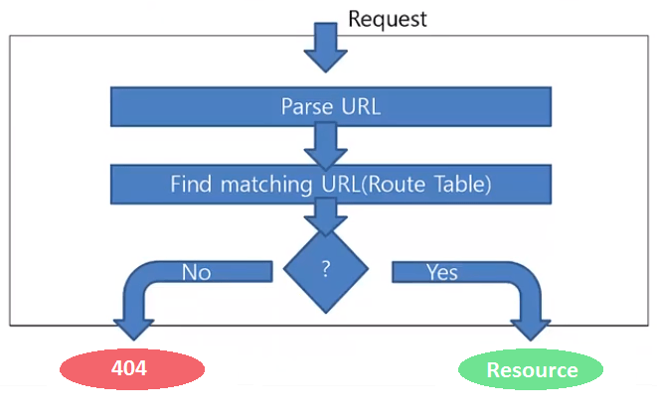
Routing
Mapping HTTP Request to HTTP Responses

Slide 30
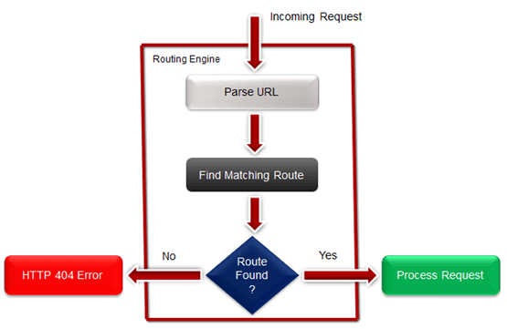
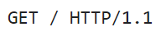
What is Web Routing?
Web Routing is a mechanism where HTTP requests are routed to the code that handles them
Requests are routed based on the HTTP
request method and the request path
HTTP requests are mapped
to HTTP responses
Example: route “/” is often
mapped to the app's Home page

Slide 31
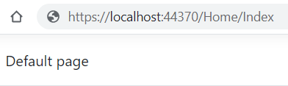
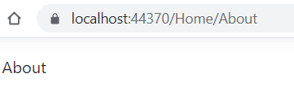
Mapping Physical Files
RouteTable.Routes.MapPageRoute
Route Name | Route URL | Physical File Name
Home | Home/Index | Index.html
About | Home/About | About.html
User-friendly URL replacement of the physical file name
void RegisterRoutes(RouteCollection routes)
{
routes.MapPageRoute("Home","Home/Index","/wwwroot/Home/Index.html");
routes.MapPageRoute("About","Home/About","/wwwroot/Home/About.html");
}

Slide 32
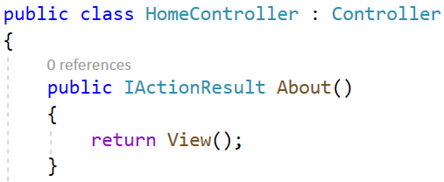
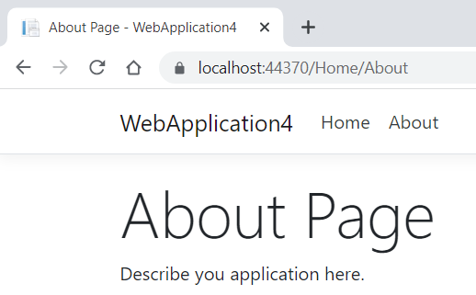
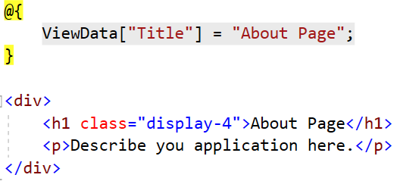
Routing in ASP.NET Core MVC
In MVC actions in controllers are mapped to .cshtml files (views)
Controller
Action
void RegisterRoutes(RouteCollection routes) {
// Default Route
routes.MapRoute(
name: “default",
url: "{controller}/{action}/{id}",
defaults: new { controller="Home", action="Index", id=UrlParameter.Optional }
}
Optional

Slide 33

HTTP Tools
Tools for Developers

Slide 34
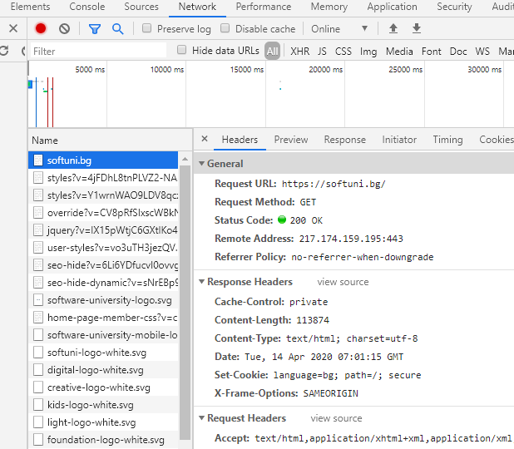
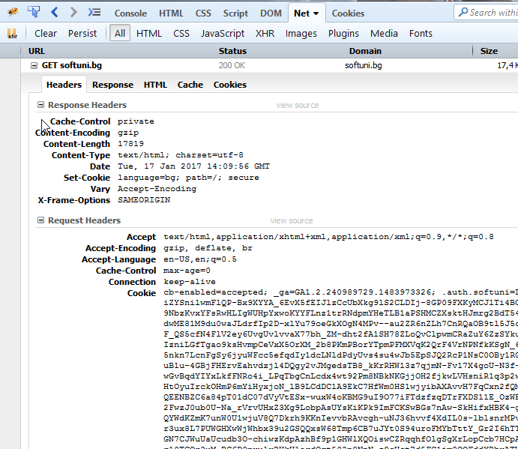
HTTP Tools for Developers – Browser (1)
Chrome Developer Tools
Firebug

Slide 35



HTTP Tools for Developers – Browser (2)
Insomnia Rest
Postman
RESTClient

Slide 36
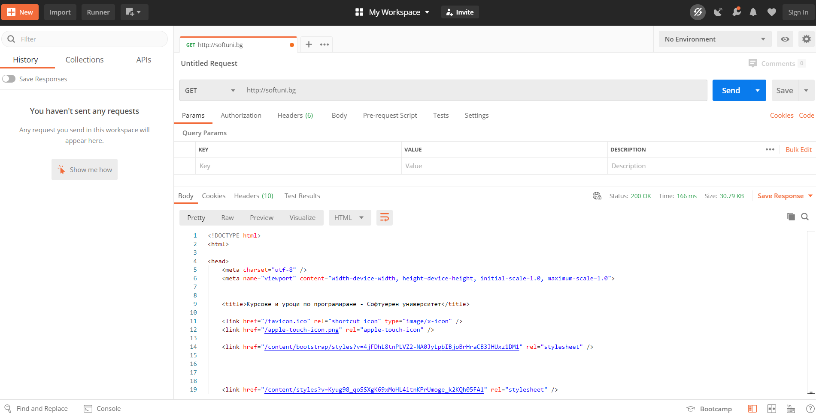
HTTP Tools for Developers – Postman
Postman

Slide 37
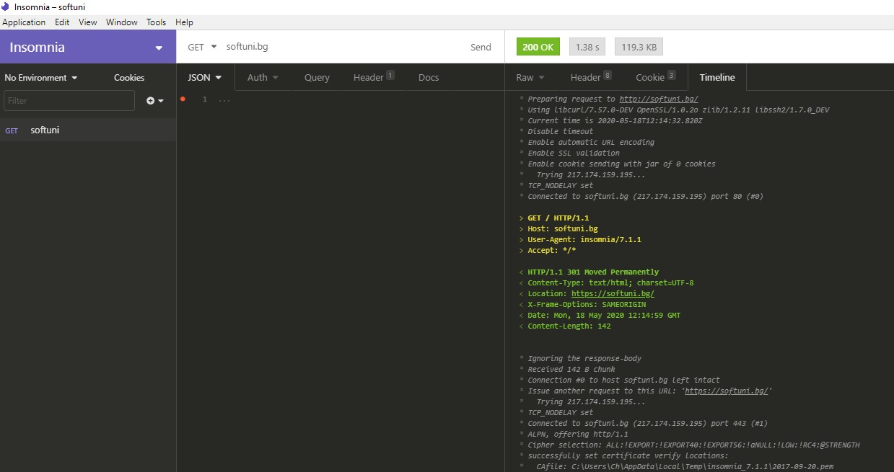
HTTP Tools for Developers – Insomnia
Insomnia Rest

Slide 38




Web Server

Slide 39

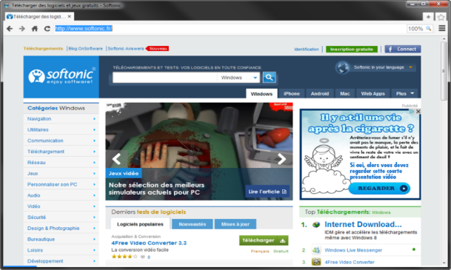



What is a Web Server?
Computer system that processes requests via HTTP, the basic network protocol
Web Client
Web Server
Communication

Slide 40

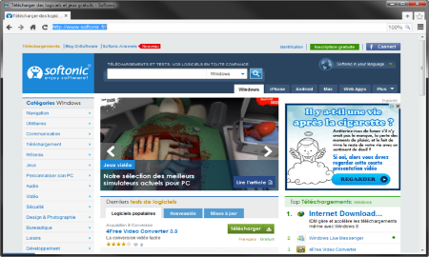
Web Server Work Model (1)
Web Server
Web Resources
Web Client
Request
Protocol
Response
HTML, PDF, JPG…
Protocols:
HTTP FTP WebSocket
Protocol
Host
Port
Resource
URL
http://localhost:8000/softuni.jpg

Slide 41



Web Server Work Model (2)
Web Server
Technology
Web Client
Request
Protocol
Response
Web Resources
Database
HTML, PDF, JPG…

Slide 42


Web Server Work Model (3)
Web Server
Technology
Spring
Web Resources
Database
HTML, PDF, JPG…

Slide 43
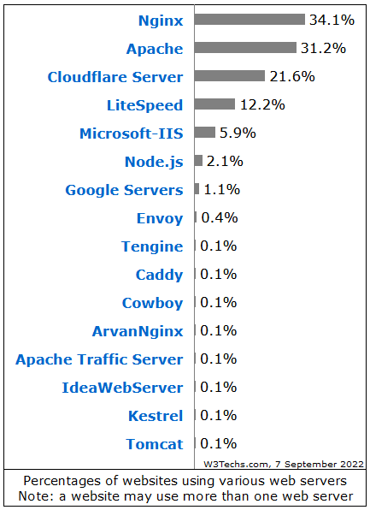

Most Popular Web Servers (W3Techs)

Slide 44
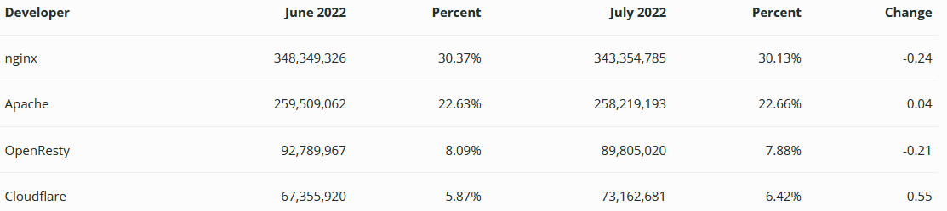
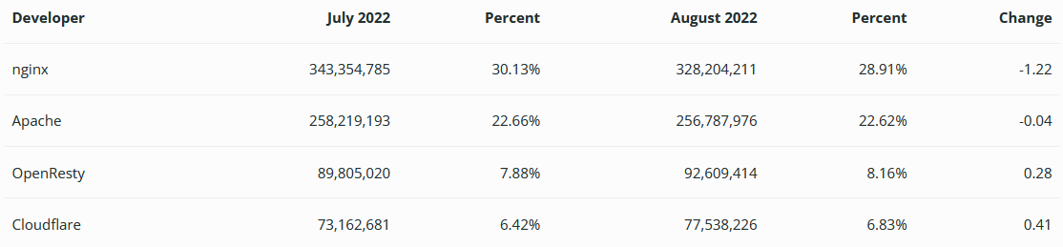
Most Popular Web Servers (NetCraft)

Slide 45



HTML Forms
Form Method and Action

Slide 46


HTML Forms – Action Attribute
Defines where to submit the form data:
<form action="home.html">
<input type="submit" value="Go to homepage"/>
</form>

Slide 47
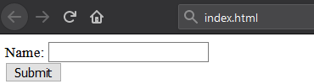
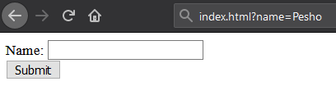
HTML Forms – Method Attribute (1)
Specifies the HTTP method to use when sending form data
<form action="/" method="get"> Name: <input type="text" name="name"> <br>
<input type="submit" value="Submit">
</form>
The form data is in the URL

Slide 48
HTML Forms – Method Attribute (2)
<form action="/" method="post"> Name: <input type="text" name="name"> <br>
<input type="submit" value="Submit">
</form>
POST http://localhost/index.html HTTP/1.1
Host: localhost
Content-Type: application/x-www-form-urlencoded
Content-Length: 10
name=Pesho
HTTP request body holds the form data

Slide 49
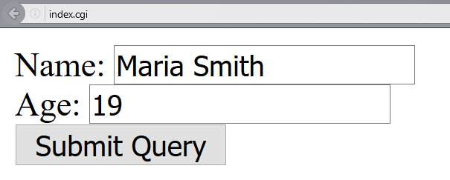
URL Encoded Form Data – Example
<form action="/" method="post">
Name: <input type="text" name="name"/> <br/>
Age: <input type="text" name="age"/> <br/>
<input type="submit" />
</form>
POST http://localhost/cgi-bin/index.cgi HTTP/1.1
Host: localhost
Content-Type: application/x-www-form-urlencoded
Content-Length: 23
name=Maria+Smith&age=19
File uploads are not supported

Slide 50
GET vs. POST Method
GET
Values are contained in the URL
Has a length limitation of 255 characters
It is often cacheable
Supports only string data types
Parameters are saved in browser history
Results can be bookmarked
POST
Values are contained in the message's body
Does not have a length limitation
It is hardly cacheable
Supports different data types
Parameters are not saved in browser history
Results cannot be bookmarked

Slide 51

HTTP/2
What's New? What's Better? What's HTTP/2

Slide 52

What's HTTP/2
HTTP/2 (originally named HTTP/2.0) is a major revision of the HTTP network protocol used by the World Wide Web
Supported by most of the popular web browsers (Chrome, Mozilla, Opera, ...)
Fast & Optimized. Meets modern web usage requirements.
Completely Backwards-Compatible.
As of Aug 2022, 50% of all the websites support HTTP/2 (W3Techs statistics)

Slide 53

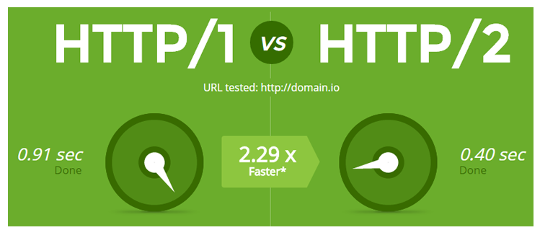
What's New?
HTTP/2 is meant to erase the need of maintaining complex server infrastructures in order to perform well
HTTP/2 communicates in binary data frames
HTTP/2 introduces several new important elements
HTTP/2 Multiplexing
HTTP/2 Header Compression
HTTP/2 Server Push

Slide 54
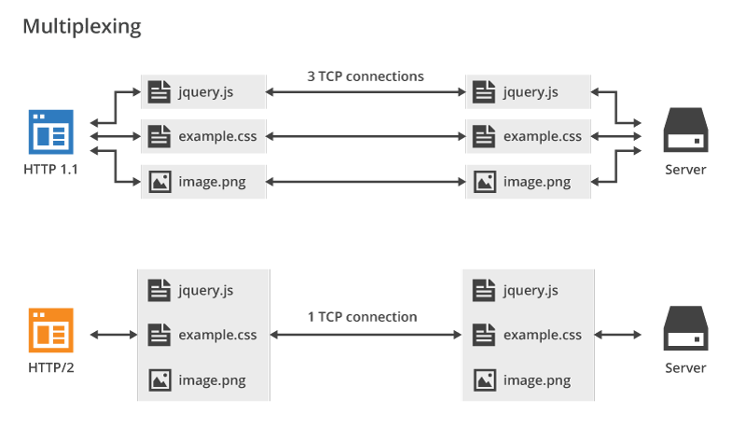
HTTP/2 Multiplexing
The art of handling multiple streams over a single TCP connection.

Slide 55
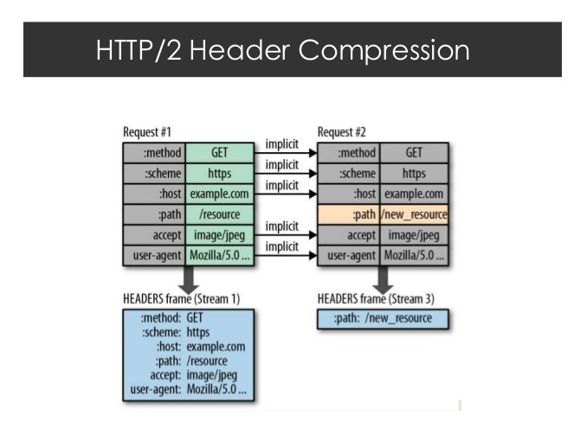
HTTP/2 Header Compression
HTTP/2 maintains a HTTP Header Table across requests
Optimizes communication drastically
The process is essentially a de-duplication, rather than compression
HTTP/2

Slide 56
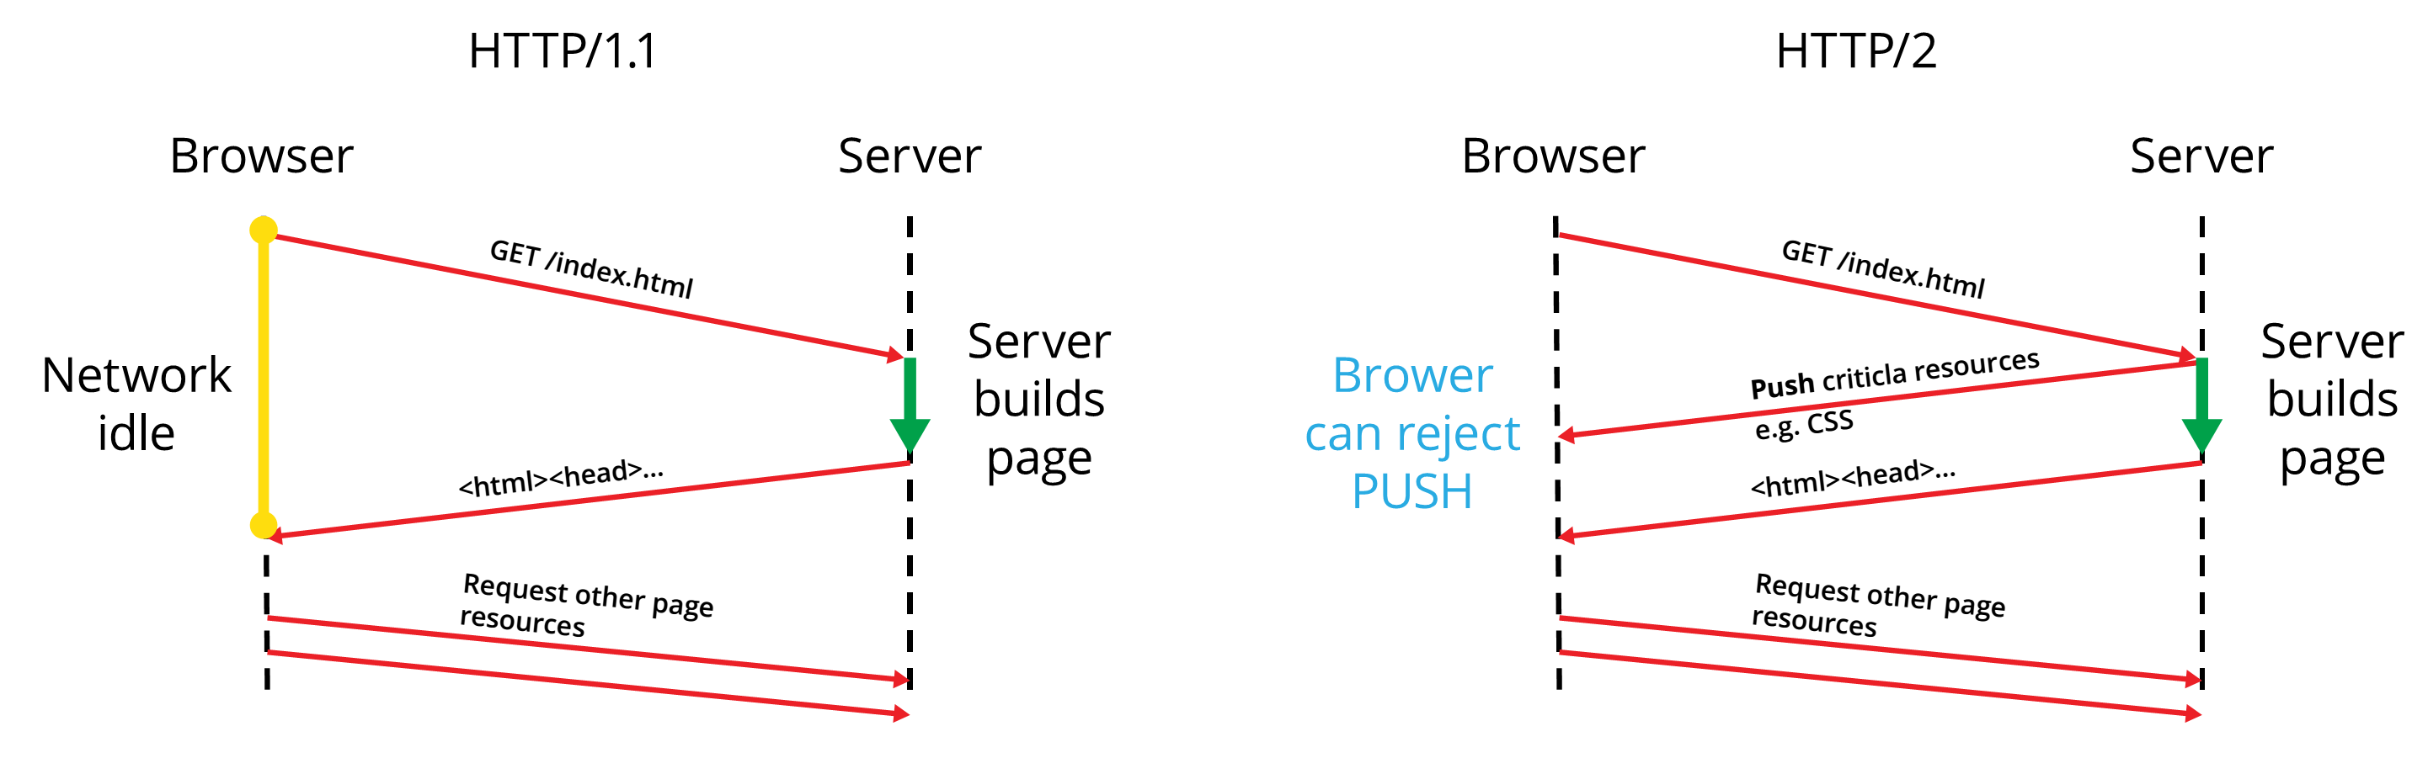
HTTP/2 Server Push
HTTP/2 Server Push is the process of sending resources to clients, without them having to ask for it.

Slide 57

HTTP/3
What's HTTP/3

Slide 58

What's HTTP/3
HTTP/3 is a new standard in development that will affect how web browsers and servers communicate
As of Aug 2022, HTTP/3 is supported by 25% of web browsers (W3Techs statistics)

Slide 59
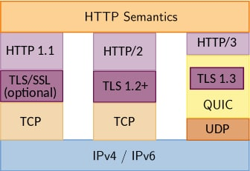
What's new?
Significant upgrades for user experience
Decreasing the effects of packet loss
Workaround for the slow performance, e. g. when a smartphone switches from Wi-Fi to cellular data
Performance, Reliability and Security

Slide 60
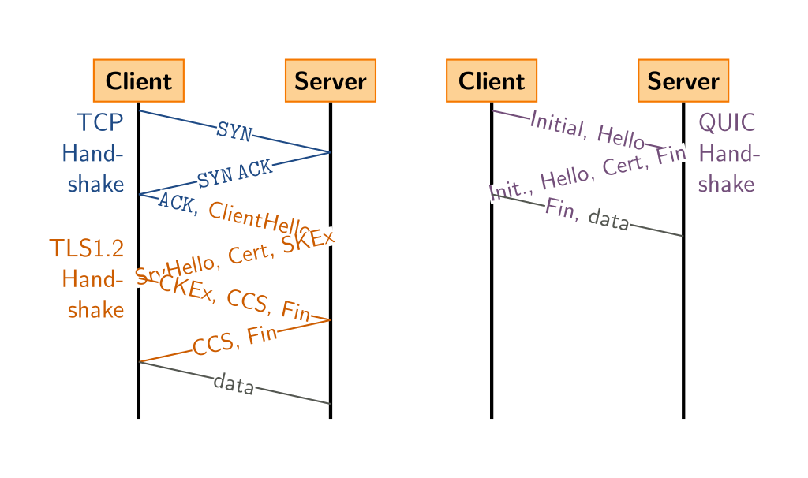
QUIC Protocol
HTTP/3 runs on QUIC, a new transport protocol designed for mobile-heavy Internet usage
Uses UDP as its basis, not TCP
Packets are encrypted individually
Exchange of supported protocols is a part of the initial handshake process

Slide 61

Summary
…
…
…
HTTP
HTML Forms & Actions
URLs
Request & Response
MIME & Media Types
Web Server
Web Communication

Slide 62
Questions?
Notes:
62

Slide 63
Trainings @ Software University (SoftUni)
Software University – High-Quality Education, Profession and Job for Software Developers
softuni.bg, about.softuni.bg
Software University Foundation
softuni.foundation
Software University @ Facebook
facebook.com/SoftwareUniversity
Software University Forums
forum.softuni.bg
Notes:
63

Slide 64













SoftUni Diamond Partners

Slide 65

Educational Partners

Slide 66

License
This course (slides, examples, demos, exercises, homework, documents, videos and other assets) is copyrighted content
Unauthorized copy, reproduction or use is illegal
© SoftUni – https://about.softuni.bg/
© Software University – https://softuni.bg
Notes:
66

